Slide 1

AI/ML & Future AI Agent Internship

Slide 2
Table Of Contents
Section | Topic Description | Page
1.0 | Learning objectives | 1
2.0 | Python fundamentals for AI , variables and data types | 4
3.0 | AI/ML VS Future AI Agent | 6
4.0 | Linux server deployment | 3
5.0 | Interview and practical questions | 4

Slide 3
Learning Objective
The main learning objectives of this internship and project are:
Understand Artificial Intelligence and Machine Learning: To develop a fundamental understanding of AI, ML, Generative AI, and AI Agent technologies and their real-world applications.
Learn Prompt Engineering: To understand how to design effective prompts and interact with AI models to generate accurate, relevant, and useful responses.
Develop AI Agent Skills: To learn how AI agents work, including task planning, decision-making, tool usage, and automated problem-solving.
Explore API Integration: To understand how APIs connect AI models with web applications and external services to enable intelligent functionality.
Build Practical AI Applications: To gain hands-on experience in developing AI-powered applications using appropriate programming languages, frameworks, and development tools.
Understand Resume Analysis: To explore how AI can analyze resumes, identify skills, extract relevant information, and evaluate candidate profiles.
Implement Intelligent Job Matching: To learn how to match candidates' skills, qualifications, and interests with suitable job opportunities using AI-based techniques.
Provide Personalized Career Guidance: To understand how an AI agent can recommend relevant skills, learning resources, and career paths based on a user's profile.

Slide 4
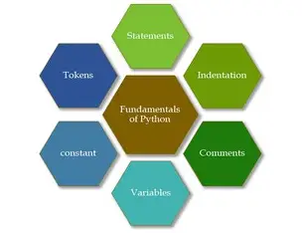
Python fundamentals for AI

Slide 5
Variables in Python
A variable is a name used to store data or values in a program. In Python, we do not need to declare the variable's data type explicitly.
EXAMPLE
name = "Neha"
age = 22
marks = 85.5
Rules for naming variables
A variable name can contain letters, numbers, and underscores (_).
It cannot start with a number.
Variable names are case-sensitive (age and Age are different).
Python keywords cannot be used as variable names.
Spaces are not allowed in variable names.
Here:
name stores text.
age stores an integer.
marks stores a decimal number.

Slide 6
Data Types in Python
Definition: A data type specifies the kind of value a variable holds.
1. Integer (int)
Whole numbers without decimal points.
age = 22
2. Float (float)
Numbers containing decimal points.
price = 99.5
3. String (str)
A sequence of characters enclosed in quotes.
name = "Neha“
4. Boolean (bool)
Represents either True or False.
Is student = True
5. List (list)
An ordered, changeable collection of items.
fruits = ["Apple", "Mango"]
6. Tuple (tuple)
An ordered, unchangeable collection.
colors = ("Red", "Blue")
7. Dictionary (dict)
Stores data as key-value pairs.
student = {"name": "Neha", "age": 22}
8. Set (set)
An unordered collection of unique elements.
numbers = {1, 2, 3}

Slide 7
Importance in AI/ML
Variables store data such as names, scores, predictions, and model parameters.
Integers and floats represent numerical data used in calculations.
Strings store text for natural language processing (NLP).
Lists and dictionaries help organize datasets and structured information.
Booleans represent conditions, such as whether a prediction meets a particular requirement.
EXAMPLE
Output
name = "Neha"
age = 22
height = 5.4
Is student = True
print(name, type(name))
print(age, type(age))
print(height, type(height))
print(is student, type(is student))
Neha <class 'str'>
22 <class 'int'>
5.4 <class 'float'>
True <class 'bool'>

Slide 8
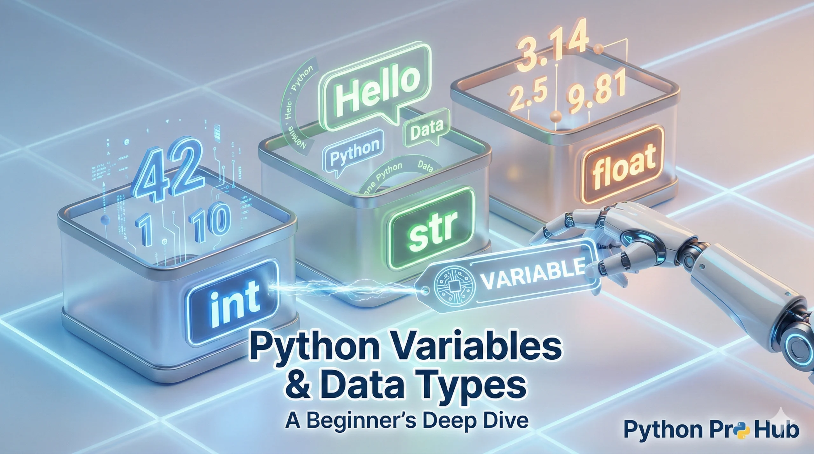
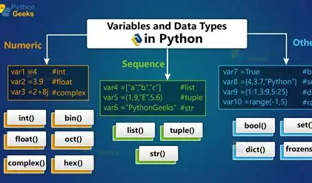

Slide 9
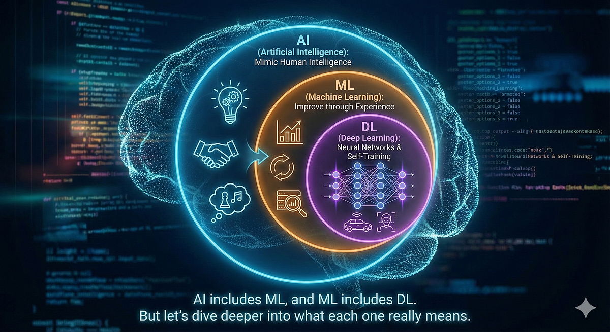
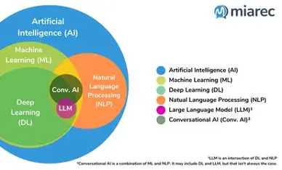

Slide 10
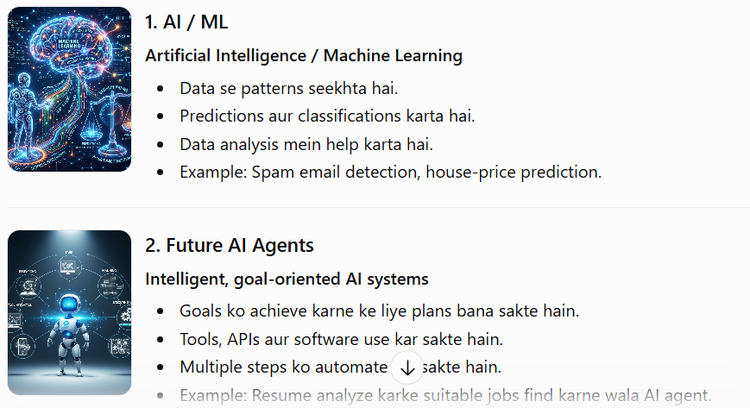
AI/ML vs Future AI Agents

Slide 11
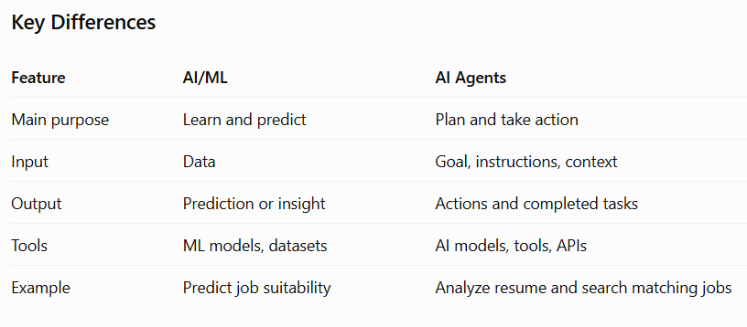

Slide 12
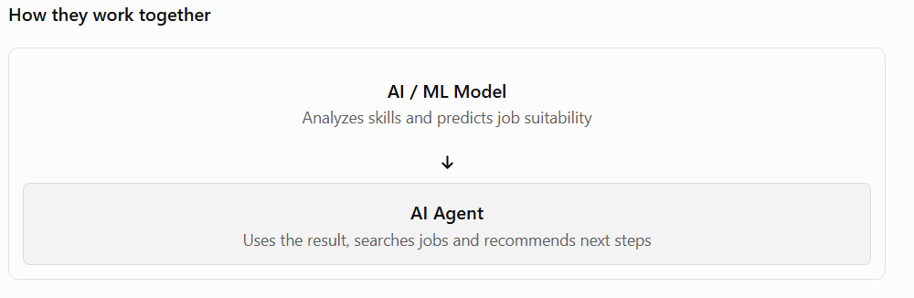

Slide 13
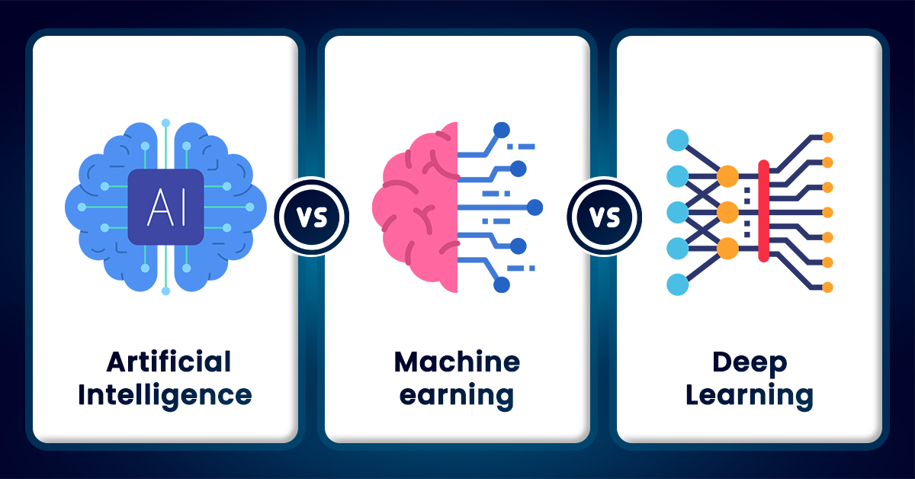

Slide 14
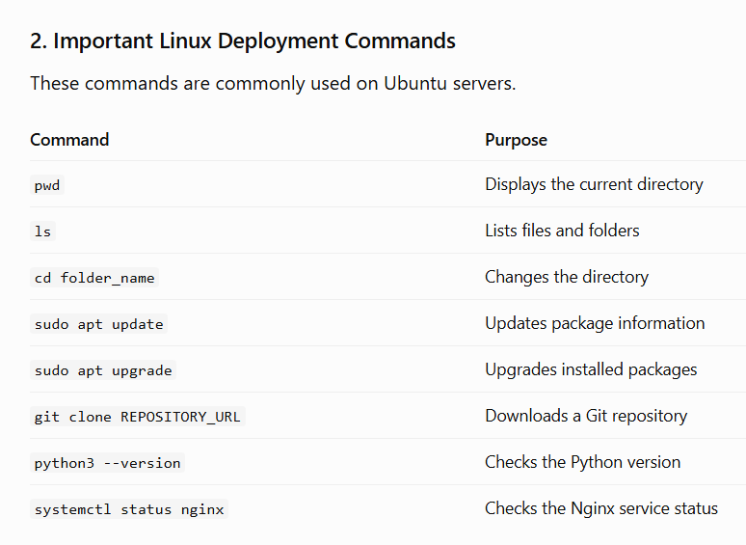
Linux Server Deployment
Linux Server Deployment is the process of installing, configuring, and running an application on a server that uses a Linux operating system so that users can access it over a network or the internet.

Slide 15
Linux Server Deployment Workflow
1. Develop the Application
Python, AI/ML model, or AI Agent
2. Prepare the Linux Server
Ubuntu / Linux, packages, dependencies
3. Configure and Deploy
Git, Python environment, application server
4. Test and Secure
Firewall, access permissions, application testing
5. Make the Application Available
Access through a website URL or API endpoint

Slide 16
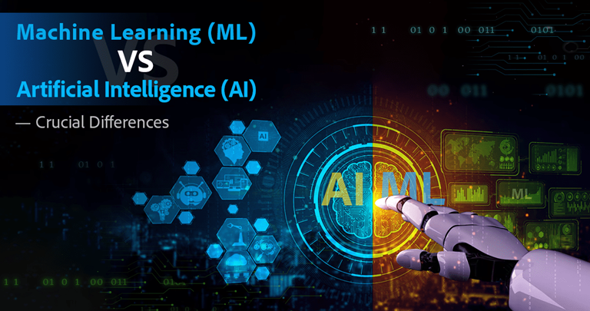

Slide 17
Interview And Practical Questions
Q1. What is Artificial Intelligence (AI)?
Answer: Artificial Intelligence is a technology that enables machines to perform tasks that normally require human intelligence, such as reasoning, learning, and decision-making.
Q2. What is Machine Learning (ML)?
Answer: Machine Learning is a branch of AI that enables computers to learn patterns from data and make predictions without being explicitly programmed for every situation.
Q3. What is the difference between AI and ML?
Answer: AI is the broader field of creating intelligent systems, while ML is a subset of AI that learns patterns from data.
Q4. What are the types of Machine Learning?
Answer:
Supervised Learning
Unsupervised Learning
Reinforcement Learning
Q5. What is Generative AI?
Answer: Generative AI creates new content, such as text, images, audio, and code, based on learned patterns

Slide 18
Q6. What is a dataset?
Answer: A dataset is a collection of related data used to train, validate, or test a machine-learning model.
Q7. What is model training?
Answer: Model training is the process in which a machine-learning algorithm learns patterns from data.
Q8. What is Prompt Engineering?
Answer: Prompt engineering is the process of designing clear and effective instructions to obtain useful responses from an AI model.
Q9. What is an AI Agent?
Answer: An AI agent is a system that observes information, works toward a goal, and may use tools or take actions to complete tasks.
Q10. What is the difference between an AI chatbot and an AI agent?
Answer: A chatbot primarily responds to user messages, whereas an AI agent can also plan tasks, use tools, and perform actions when appropriately configured.
Q11. What are the main components of an AI Agent?
AI model or reasoning engine
Instructions and goals
Tools and APIs
Memory or context, when needed
Planning and action execution

Slide 19
Q12. What is an API?
Answer: An API (Application Programming Interface) allows different software applications to communicate and exchange data.
Q13. What is an autonomous AI agent?
Answer: An autonomous AI agent can perform multiple steps toward a goal with limited human intervention, within its configured permissions and boundaries.
Q14. What is tool calling in AI Agents?
Answer: Tool calling allows an AI agent to use external functions or services, such as searching the web, retrieving information, or accessing an API.
Q15. What is Linux?
Answer: Linux is an open-source operating system widely used in servers, cloud computing, development, and AI applications.
Q16. What is Linux Server Deployment?
Answer: It is the process of configuring a Linux server, installing an application and its dependencies, and making the application available to users.
Q18. What is the difference between ls and cd?
Answer: ls lists files and folders, while cd changes the current directory.
Answer: Git is a version control system used to track code changes and collaborate on software projects.
Q19. What is a virtual environment in Python?
Answer: A virtual environment isolates a project's Python packages from other projects and the system-wide Python environment.

Slide 20
